Slide 1
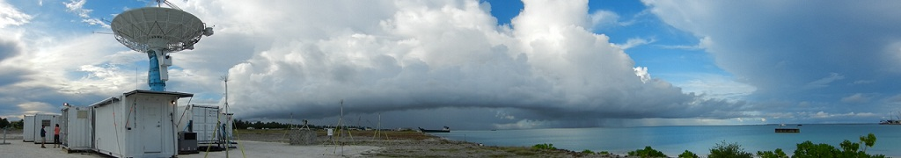
Introduction to Weather Radars
Hannah Vagasky
AER Lunch & Learn
August 13, 2024

Slide 2
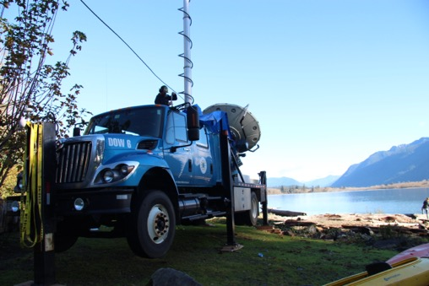
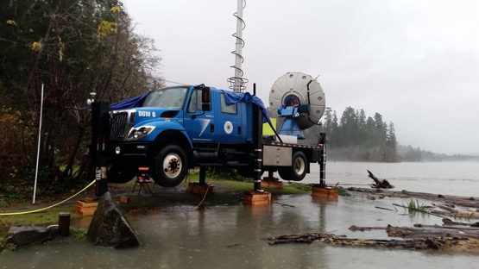
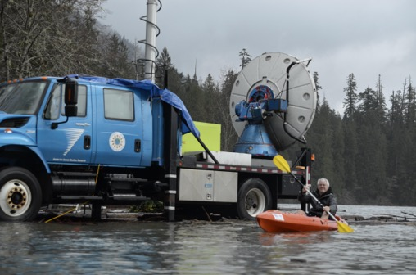
Outline
What are radars and how do they work
Brief history of radars
The NEXRAD radar network
Different types of weather radars
Doppler
Polarimetric
Mobile and satellite radars
Weather Radar Analysis
Bow echo
Hook echo
Tornadic winds and debris signatures
How AER uses radar data
The future of radars
Radar resources
https://olympex.atmos.washington.edu/Photos.html

Slide 3
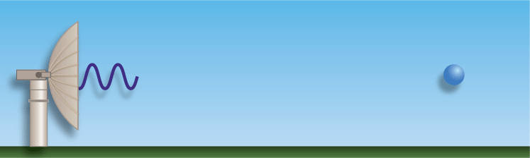
What are Radars and How They Work?
Radar is an acronym: Radio Detection And Ranging
Definition:
A system that determines the location of objects by sending out short pulses of radio waves and measuring the time it takes for the wave to be reflected from the objects (Cambridge Dictionary)
Can be used to detect aircraft, vehicles, ships, missiles, precipitation, birds/insects, and surface variability below ground
https://www.weather.gov/mlb/Doppler_Dual_Pol_Weather_Radar

Slide 4
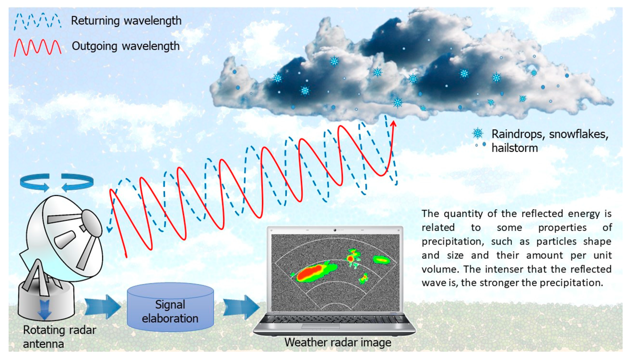
How Radars Detect Precipitation
https://www.mdpi.com/2673-4834/3/1/12#B7-earth-03-00012

Slide 5
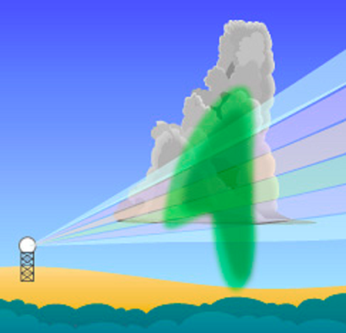
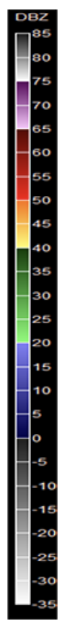
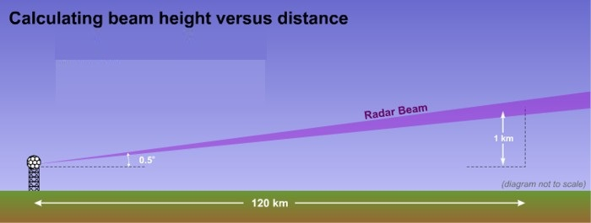
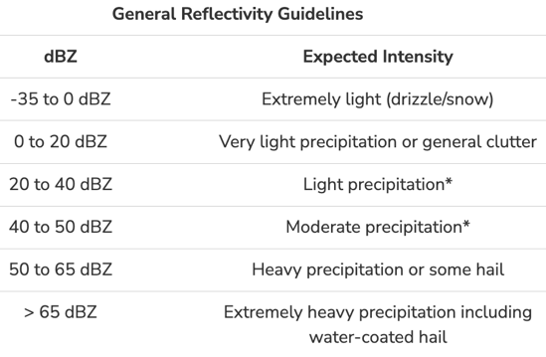
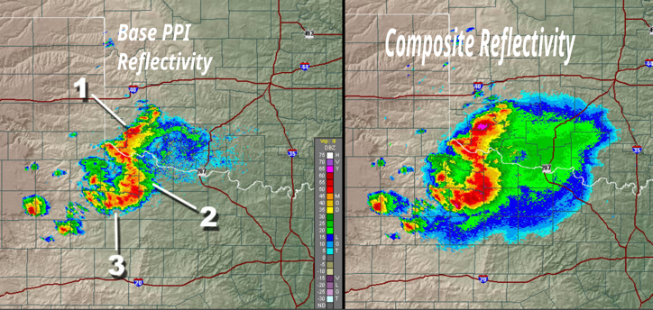
Radar Reflectivity
Radar Reflectivity = Amount of power in the radio wave that is returned to the radar
Proportional to number of detected particles and their cross sectional area
Reported in dBZ, which is a logarithmic power unit
Weather radars continuously scan the atmosphere making 360º circles at different elevation angles
The height of the beam increases as it gets further from the radar
Base reflectivity uses data from the scan closest to the surface
Composite reflectivity shows the highest reflectivity in the vertical column
https://www.kfyrtv.com/2022/06/27/morse-code-weather-how-weather-radar-creates-3-d-picture-atmosphere-detect-precipitation/, https://en.wikipedia.org/wiki/Composite_reflectivity,

Slide 6
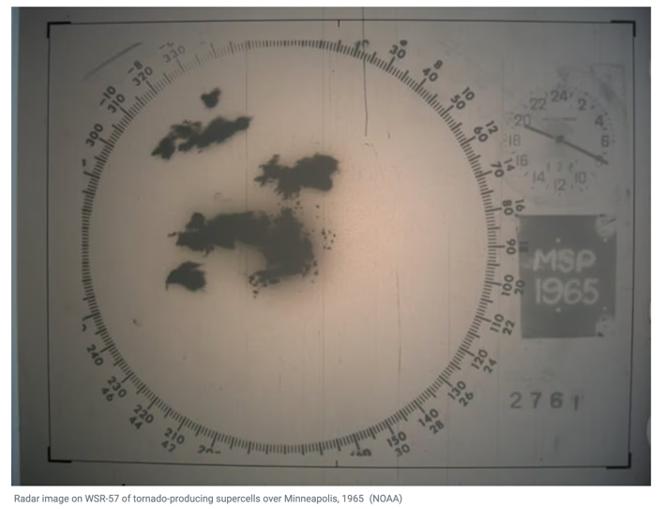
Brief History of Radars
German scientists in the late 1800s and early 1900s started to discover that radio waves could be reflected from solid objects and used to detect these objects (ships in fog)
Prior to World War II, numerous countries developed radars for military purposes with great secrecy to track aircraft
The ability for radars to detect precipitation was recognized during World War II.
The development of weather radars in the United States started in 1942 when the US Navy donated 25 surplus radars to the Weather Bureau
First radar network in the US deployed in 1957
https://www.kfyrtv.com/2022/07/30/morse-code-weather-history-weather-radar-wwii-technology-present-day-applications/
https://en.wikipedia.org/wiki/Radar, https://en.wikipedia.org/wiki/Weather_radar#History

Slide 7
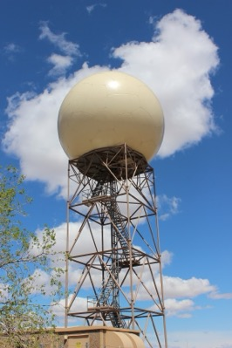
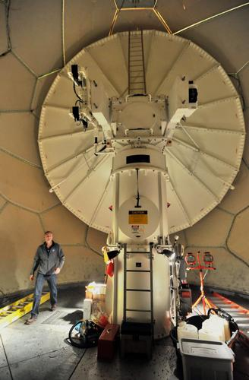
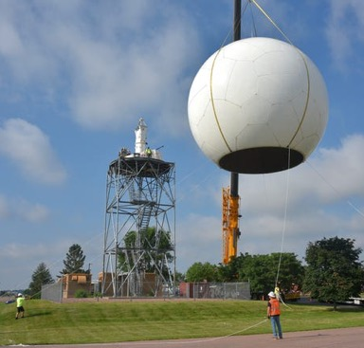
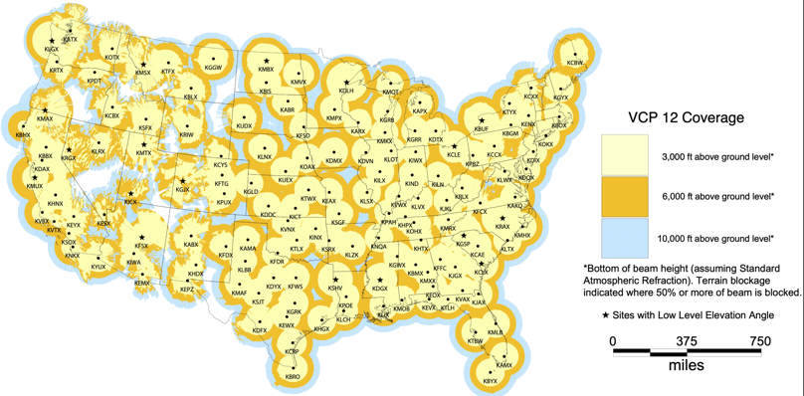
The NEXRAD Network
NEXRAD = Next Generation Weather Radar
Current network of 160 weather radars operated by the government
May also hear them referred to as WSR-88D radars, which is the technical name for the radars themselves (Weather Surveillance Radar 1988)
Timeline
1970s – The government decided that the previous radar network needed to be upgraded/replaced
1990 – First operational protype deployed
1992 – 1997: Nationwide deployment
2010 – 2013: Radars updated nationwide
Radars are currently Doppler and polarimetric
https://upload.wikimedia.org/wikipedia/commons/e/e4/NEXRAD_map.jpg, https://www.farmforum.net/story/news/2022/06/24/nws-upgrades-sioux-falls-radar-expects-downtime-last-another-week/7722778001/, https://www.heraldandnews.com/news/oregon/noaa-seeks-funding-to-repair-weather-radar-on-mount-ashland/article_1b94efcf-06e5-5cba-8a8d-9164db05dc78.html, https://www.weather.gov/abq/radarslep

Slide 8
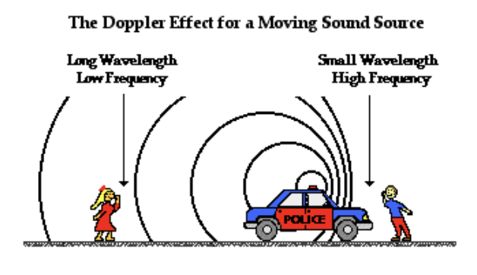
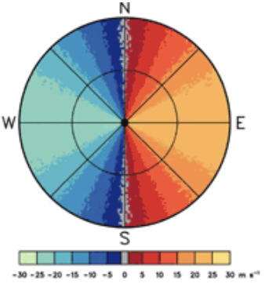
Types of Radars: Doppler
Radars measure the strength and phase of the reflected radio wave
The phase difference between the emitted and returned radio waves is used to determine if the precipitation is moving towards or away from the radar and how fast
A single radar cannot determine the 3D winds
Idealized Radial Velocity Display
The Doppler Effect for a Moving Sound Source
Winds Toward the Radar:
Negative Values
Cool colors
Longer wavelength
Lower frequency
Smaller wavelength
Higher frequency
Winds Away from the Radar:
Positive Values
Warm colors
https://www.physicsclassroom.com/class/waves/Lesson-3/The-Doppler-Effect
https://www.nssl.noaa.gov/publications/dopplerguide/chapter2.php

Slide 9
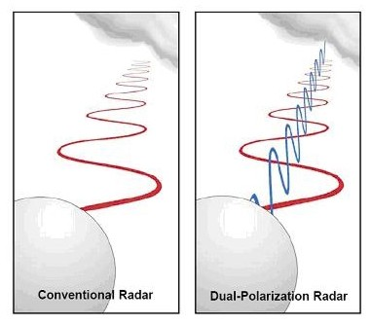
Types of Radar: Polarimetric
At first radars, only emitted and receive horizontally oriented radio waves
Some radars are now able to emit and receive horizontally and vertically oriented radio waves
Additional radar variables are obtained by comparing the returned power and phase of these different waves
Example: Differential reflectivity, correlation coefficient
These additional variables provide insight into the precipitation
Example: shape, orientation, melting

Slide 10
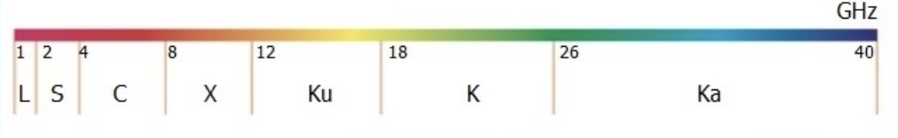
Types of Radar: Different Wavelengths
A range of radio wavelengths can be used in weather radars
The range of wavelengths used is broken into “radar bands”
The NEXRAD network is S – Band
Each band has strengths and weaknesses
Radar Frequencies and Bands
Can reliably detect large particles
Sensitive to small drops
Can penetrate heavy precipitation
Obscured by heavy rain
Requires larger antenna and more power
Requires smaller antenna and less power

Slide 11
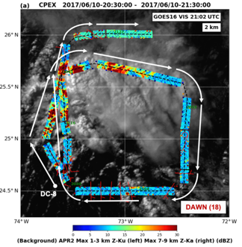
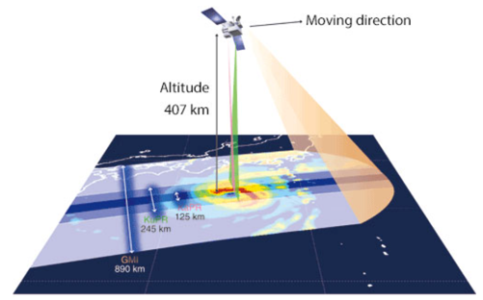
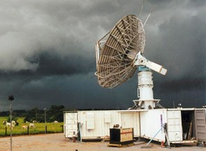
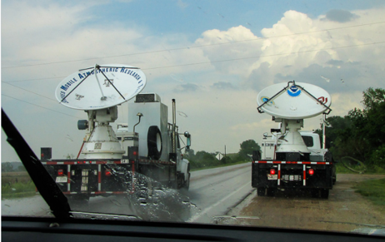
Types of Radar: Mobile and Satellite
Diverse group of instruments in terms of mobility/platform and wavelength
Largest
Smallest
Stationary, ”easily” transportable
Ex: NCAR S-Pol (S – Band)
Truck Mounted
Ex: SMART-R and NOXP (X – Band)
Aircraft Mounted
Ex: NASA APAR-2 (Ku- & Ka- Band)
Satellite
Ex: NASA GPM Precipitation Radar (Ku- & Ka- Band)
Very active research area
https://global.jaxa.jp/countdown/f23/overview/gpm_e.html, https://www.nssl.noaa.gov/tools/radar/, https://news.ucar.edu/3993/radars-next-phase, https://amt.copernicus.org/articles/13/4521/2020/#&gid=1&pid=1

Slide 12
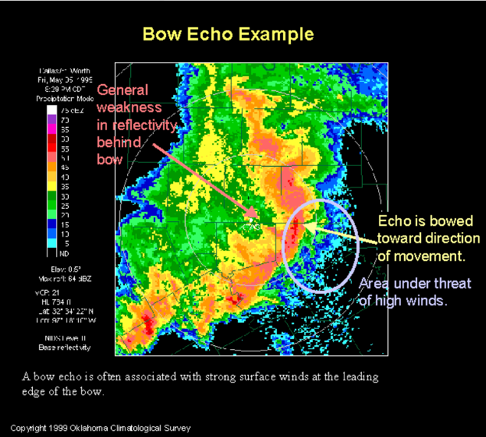
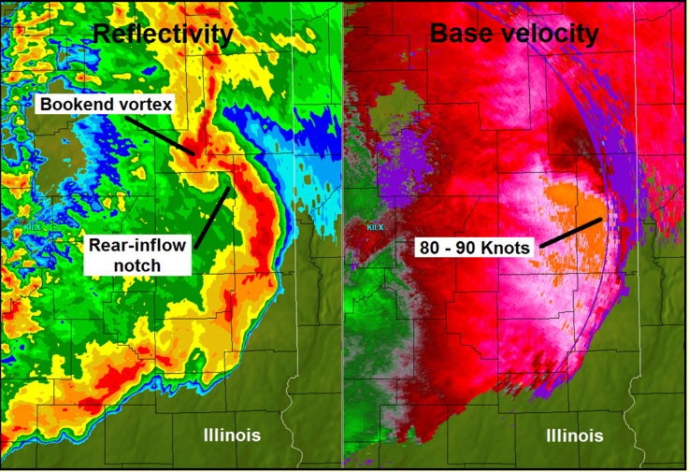
Weather Radar Analysis: Bow Echo
Bow Echo = Line of storms that arches outward in the direction it is moving
Often associated with strong straight-line winds, tornadoes are also possible
May be classified as a derecho if it meets duration and intensity requirements
Must persist for at least 400 mi, have 58 mph wind gusts along most of its length, and have several, well separated pockets of 78 mph gusts
https://www.spc.noaa.gov/misc/AbtDerechos/casepages/apr202011page.htm, https://commons.wikimedia.org/wiki/File:Bow_echo_diagram.svg, https://en.wikipedia.org/wiki/Derecho#:~:text=A%20derecho%20(%2F%CB%88d%C9%9B,as%20a%20mesoscale%20convective%20system.

Slide 13
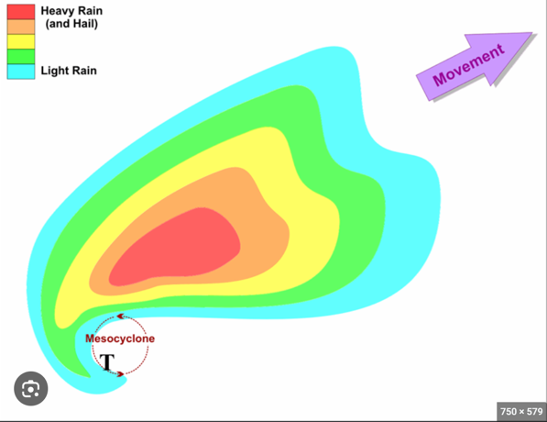
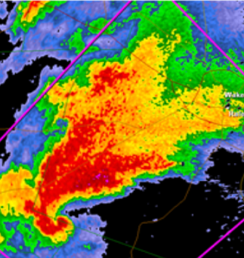
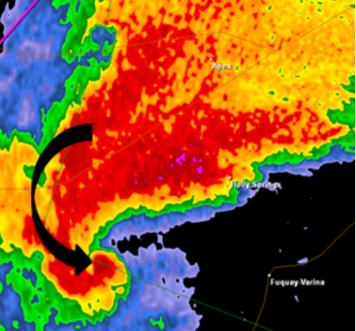
Weather Radar Analysis: Super Cells and Hook Echo
Super cell = A storm that contains a deep, rotating updraft
Least common type of thunderstorm, but most destructive
Can produce strong tornadoes and large hail
A hook echo is a reflectivity appendage that results from precipitation being wrapped around the back of the rotating updraft
This is the most likely location for a tornado
Observed Super Cell on April 27, 2011, in North Carolina
Updraft
Model of a Super Cell
https://www.ustornadoes.com/2013/02/14/understanding-basic-tornadic-radar-signatures/, https://www.e-education.psu.edu/meteo3/l9_p9.html

Slide 14
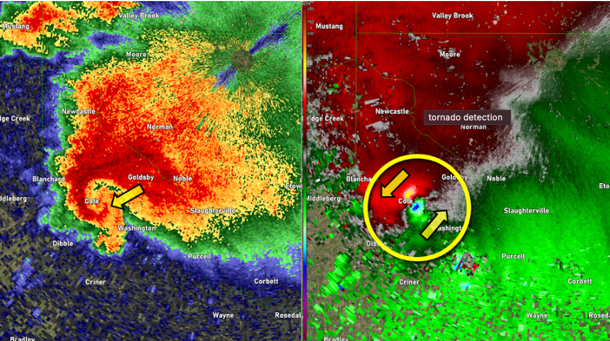
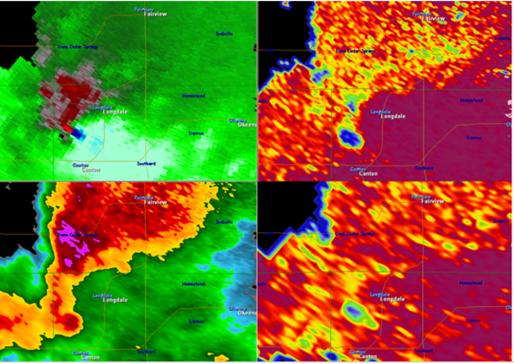
Weather Radar Analysis: Tornado Signatures
Tornado Vortex Signature / Velocity Couplet
A tight couplet of strong winds away from and towards the radar
Often associated with a rotating updrafts (not the actual tornado)
The radar beam is often too high or the tornado is too small to be directly observed
A tornado is possible, but not guaranteed
Tornado Debris Signature / Tornado Debris Ball
One of the polarimetric variables has decreased values when non-meteorological particles are detected (cross correlation coefficient)
A debris signature occurs when this variable has decreased values in a region with high reflectivity and a velocity couplet
Indicative of a tornado causing destruction
https://www.noaa.gov/jetstream/velocity, https://www.weather.gov/lmk/nws_radar_dualpol_tordebris

Slide 15
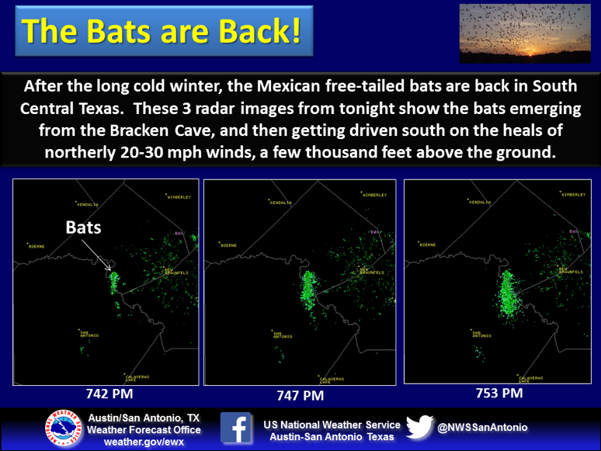
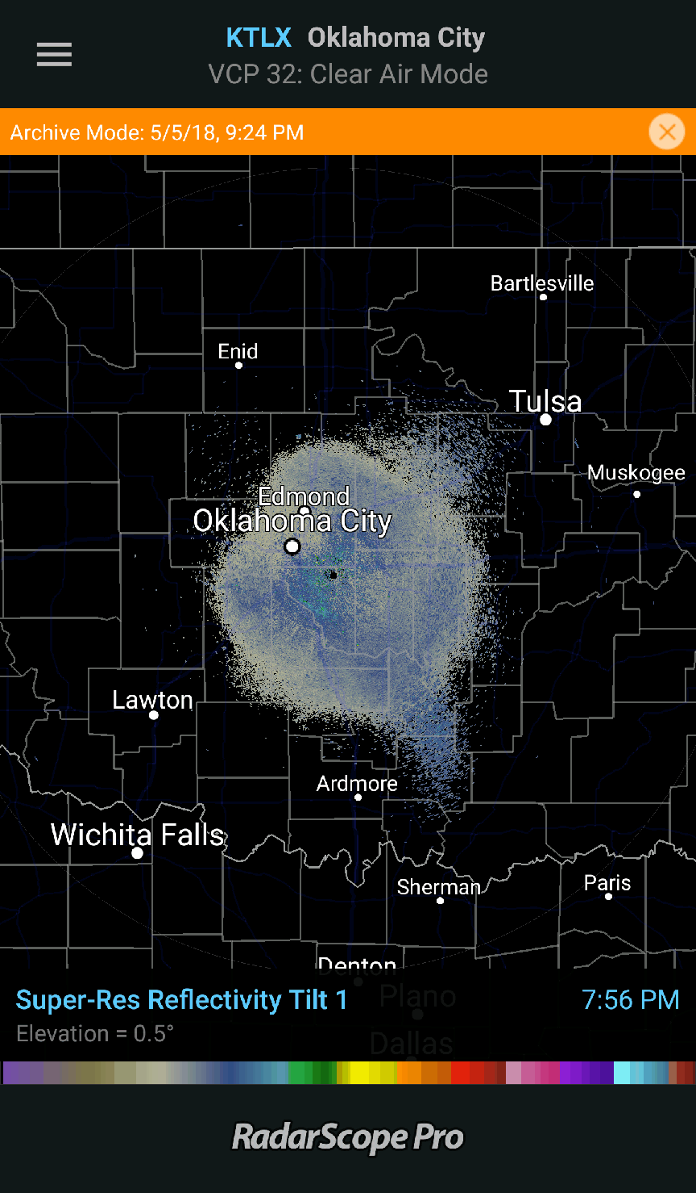
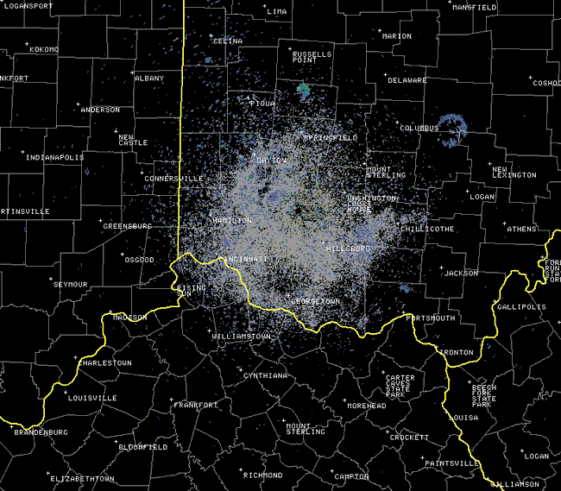
Weather Radar Analysis: Non-Meteorological
Weather radars detect more than precipitation and have been used to study insect, animal behavior
Blooms
Bugs (and migrating birds) taking off in the evening and flying overnight
Why reflectivity sometimes increases overnight near the radar
Bats
Bird Roost Rings
Birds taking off in the morning and flying in all directions
These are purple martins taking off from roosts near lakes in Ohio
https://www.weather.gov/iln/birds, https://radarscope.zendesk.com/hc/en-us/articles/4416722636946-Biological-Scatter-What-You-Can-See-On-Radar-Other-Than-Rain, https://x.com/NWSSanAntonio/status/447911878635708416

Slide 16
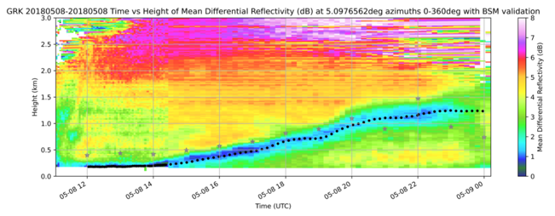
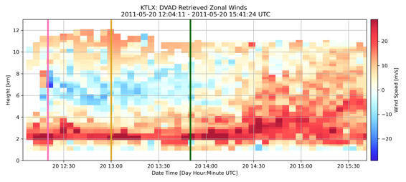
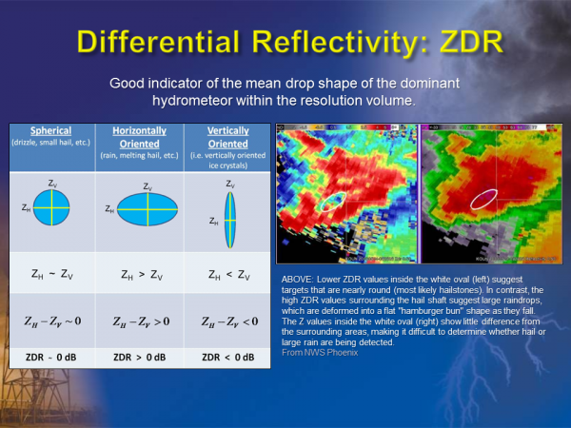
How AER Uses Radars
Estimation of the height planetary boundary layer
Planetary boundary layer = lowest layer of the atmosphere and is directly influenced by the surface
We are using the lowest radar scan and polarimetric variables to determine the top height of this layer and how it changes over time
Derive horizontal and vertical winds
The velocity from two nearby radars can be used to derive the 3-D winds in a region
This technique is being used to estimate winds behind a bow echo and in hail producing storms
We are using the highest radar scan to estimate the horizontal winds directly over the radar behind a bow echo
ICECHIP and Hail Analysis
Several mobile radars will be deployed during ICECHIP
Will be used to help us understand the evolution of the hail and determine the winds within the storm
https://www.tceq.texas.gov/downloads/air-quality/research/reports/misc/5822345974015-20240626-planetary-boundary-layer-pbl-verification-with-2022-tracer-aq-field-study-data.pdf, https://earthsky.org/earth/nws-upgrades-to-dual-polarization-radar-for-better-look-at-precipitation-tornadoes/

Slide 17
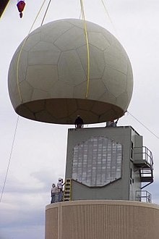
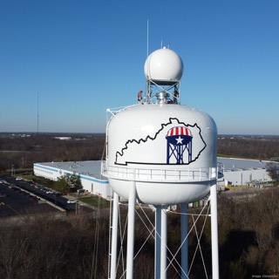
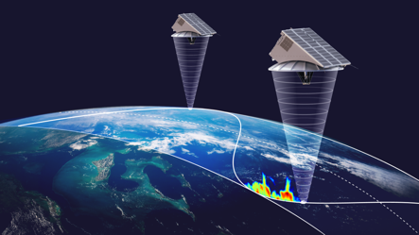
The Future of Radars
The Future of the NEXRAD Network
Part of Weather Act Reauthorization Act of 2023 requires that the NEXRAD network be replaced by 2040
Currently in the planning and development phase
The next generation of radars will be Phased Array Radars.
These radars have flat panels that are stationary, which will allow for more flexibility in how the radar scans
The National Weather Service’s phased array radar was a decommissioned radar from the US Navy in 2003
Commercialization of radar data
“Gap Filling” Radars
Large portions of the country have poor NEXRAD radar coverage
Private companies such as Climavision have started to try to tackle this issue
24 X-band radars deployed at the end of 2023, plans for a total of 200
Satellites
Many portions of the world, especially in poor nations, lack radar coverage
Companies such as Tomorrow.io are launching a suite of Ka-Band radars to provide global coverage that is updated more frequently
Several launched since 2023, data available as of 2024
https://www.tomorrow.io/blog/tomorrow-io-announces-successful-precipitation-scans-from-its-space-radars/, https://www.bizjournals.com/louisville/inno/stories/news/2024/01/24/climavision-radar-install-weather-tech-dry-ridge.html, https://www.congress.gov/bill/118th-congress/house-bill/6093/text/ih#toc-HA36573D5DAC24FFA91DFFFE25CF1771A

Slide 18

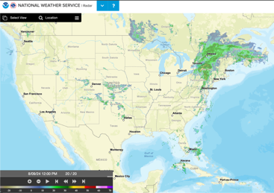
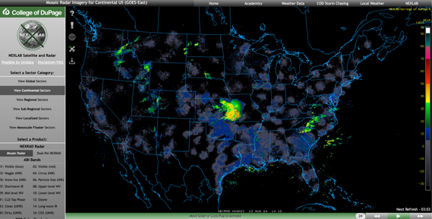
Radar Resources
RadarScope
My favorite app, available in all app stores
NWS Radar Website
https://radar.weather.gov/
Alternative Radar Website
Less user friendly
https://weather.cod.edu/satrad/?parms=continental-conus-comp_radar-24-0-100-1&checked=map&colorbar=undefined

